Slide 1
GSKY – Accelerated Pyramid
Presentation and Technical Documentation
To enhance the user experience and reduce the server load when displaying DEA satellite layers via TerriaMap.
Copyright © 2019 by National Computational Infrastructure, Canberra, ACT, Australia. Author: Dr. Arapaut V. Sivaprasad.
24 July, 2019

Slide 2
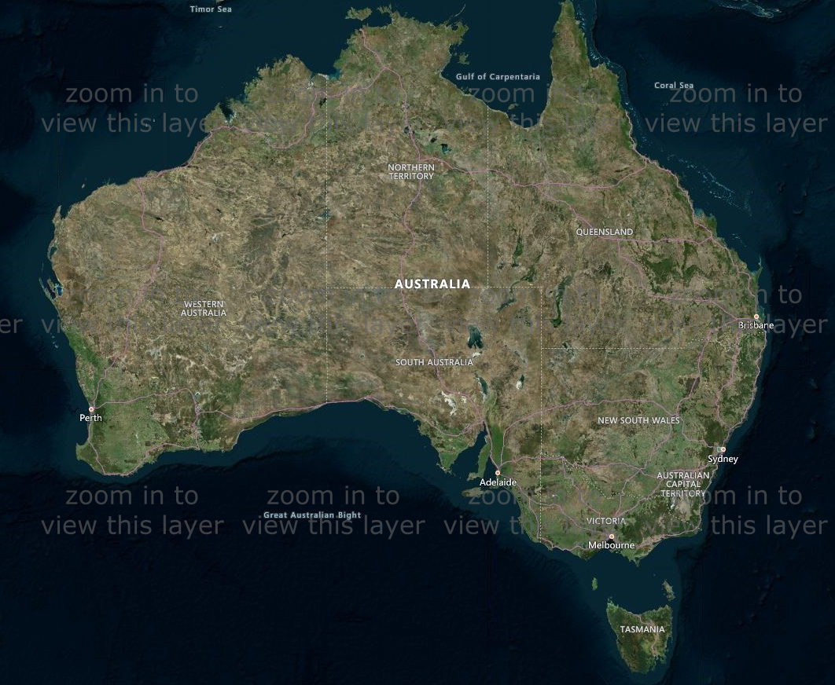
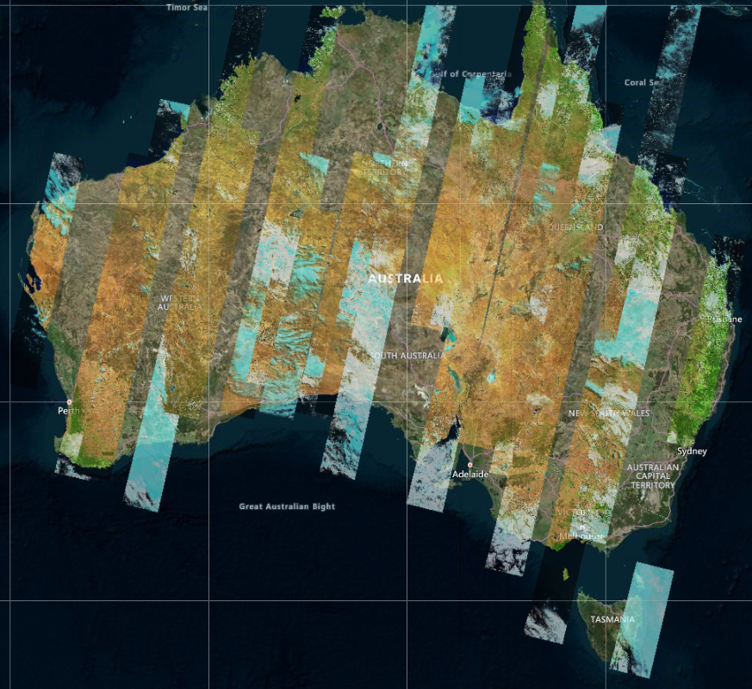
Introduction
GSKY creates composite PNG images from NetCDF files.
It can process only small areas.
Large areas result in a timeout.
No continent-wide view is possible.
We are trying to make the continent view possible as below…

Slide 3
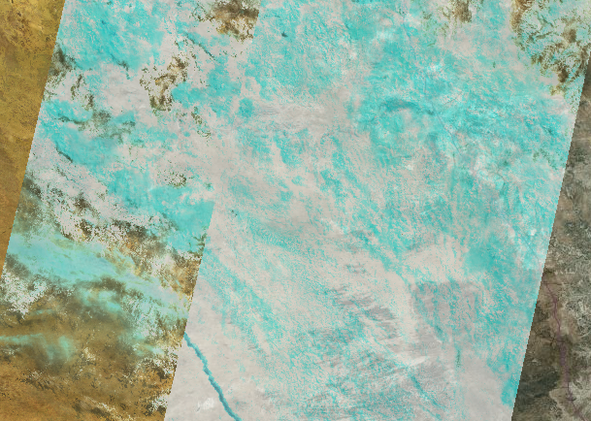
Introduction
Currently to view any data…
Must zoom in to 50km or less zoom level.

Slide 4

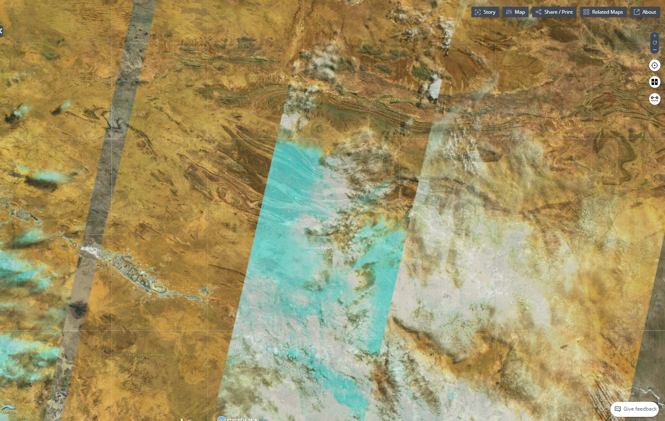
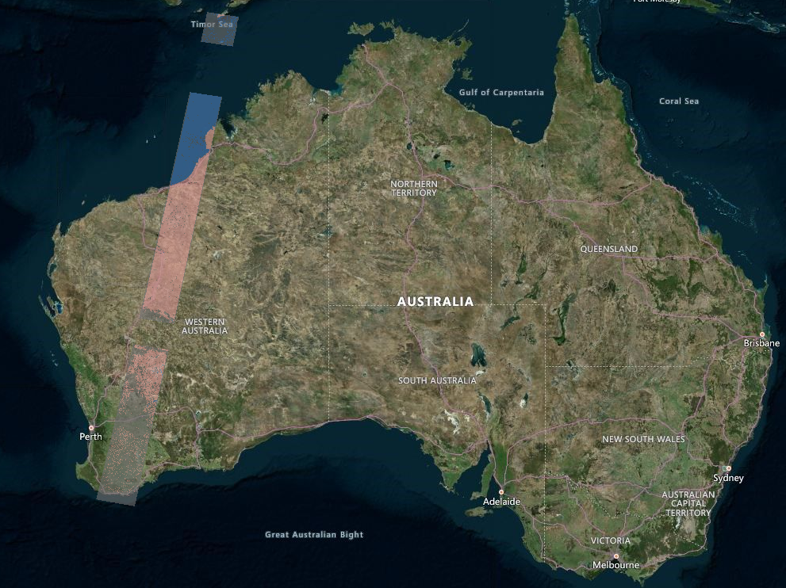
Objectives
Be able to view the swaths at all zoom levels.
Then, it must be possible to zoom in for greater details.
On the left is a continent-wide display on which it is easier to draw a bounding box to zoom in.
When the data is sparse it becomes even more useful to have a continent-wide display.

Slide 5
Benefits
Fast display.
Better user experience.
Reduced server load.
>> Demo
TerriaMap Instance: http://130.56.242.6/terria/
GetCaps End Point: http://130.56.242.15/ows/ap

Slide 6
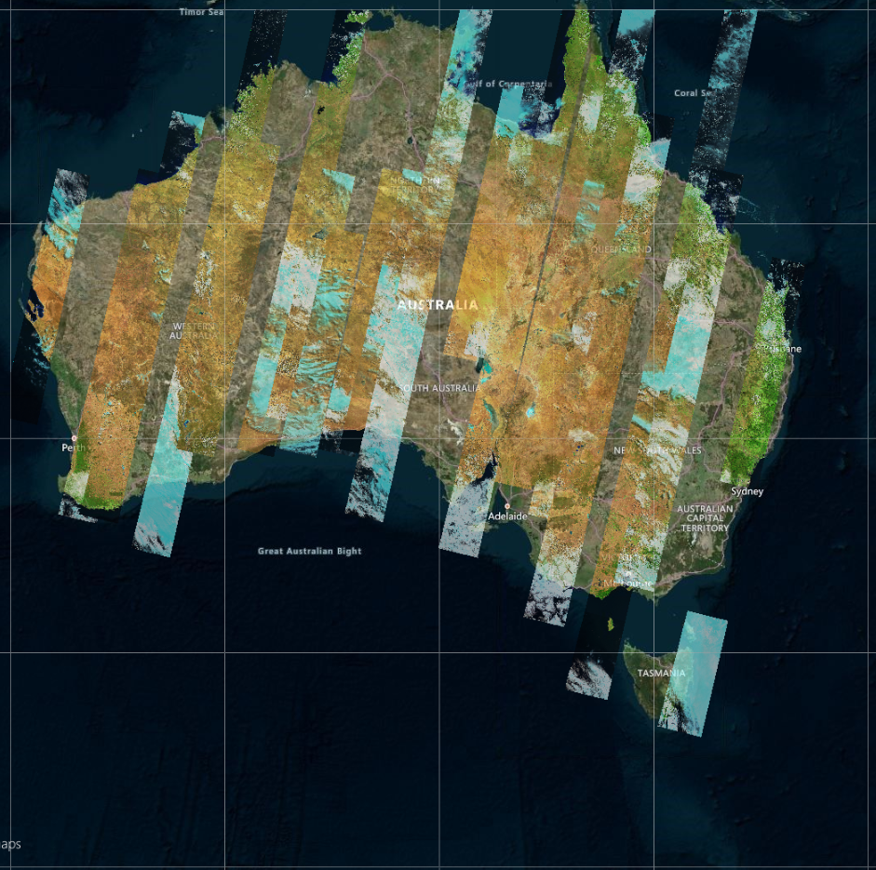
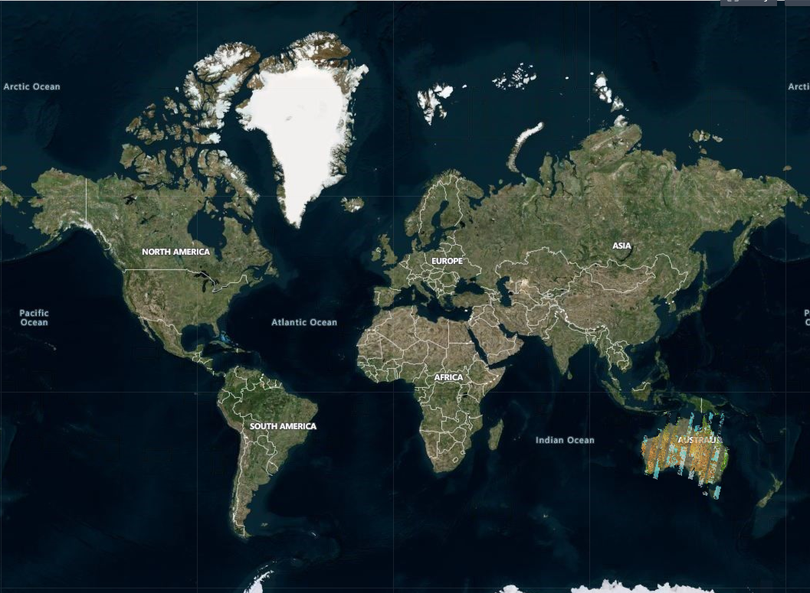
Methodology
Caching the images as *.png files.
TerriaMap divides the map into tiles…
1 tile to cover Australia at world-level zoom.
14 tiles at continent-level zoom.
Tiles are divided into 4 at each higher zoom level.
1
2
3
4
5,000 km : 1tile
3,000 : 1
1,000 : 3 tiles
500 : 6
300 : 14
200 : 64
100 : 256
50 : 1024
20 : 4096
10 : 16,384
5 : 65,536
3 : 262,144
1 : 1,048,576
500 m : 4,194,304
300 : 16,777,216
200 : 67,108,864
100 : 268,435,456
50 : 1,073,741,824
5
6
7
8
9
10
11
12
1
13
14

Slide 7
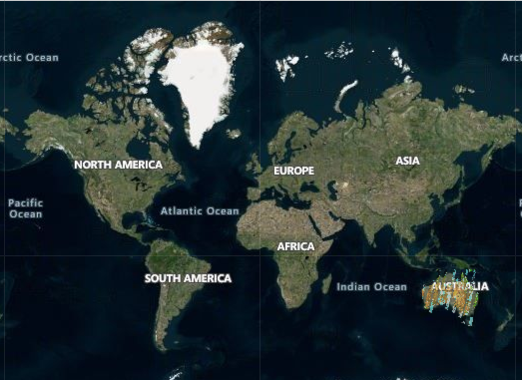
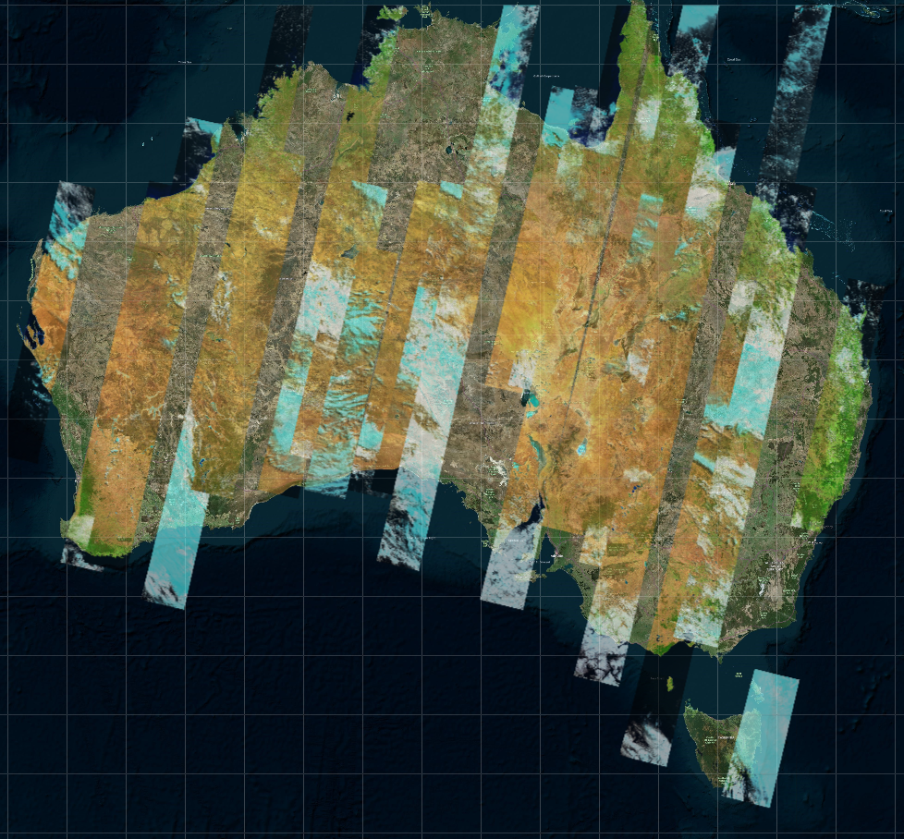
Methodology
Tiles at zoom levels 3,000km to 10km (9 levels) are cached.
16,384 tiles at 10km zoom.
Tiles increase to >1 billion at the highest zoom level of 50m.
Impractical to cache all zoom levels.

Slide 8
Methodology
Prepared a list of bounding boxes (BBOX) for zoom levels 3,000 km to 10 km.
Calculate the BBOX for each tile at a particular zoom level.
Send these BBOXes via ‘curl’ to GSKY server to get the tiles.
e.g. curl ‘http://…/ows?time=…&bbox=….&width=256&height=256’ > tile.png
Time varied from < 1 to 400 seconds per tile.
Total for one time slice: ~3 hours, when run sequentially.
Expecting this to average out as 1 hour.
Total time slices: ~16,000
Total execution time: ~16,000 hours (16 KSUs in parallel or 1.8 years in serial)
Working on parallelizing the process on Raijin
Aiming to reduce the total time to < 12 hours
Time slice storage: ~1GB
Expecting this to be an average of 400MB per time slice
Total storage: 6.4TB

Slide 9
Technical Details
GSKY code change to cache the tiles*
ows.go is set to write the PNG to a file instead of to the web.
create_tile = flag.Bool("create_tile", true, "For Google Earth Web Service.")
if(*create_tile) { // AVS: Write it in a local file.
ts := fmt.Sprintf("%v",*params.Time)
date := strings.Split(ts, " ")
s := fmt.Sprintf("%.8f_%.8f_%.8f_%.8f", params.BBox[0],params.BBox[1],params.BBox[2],params.BBox[3])
tile_dir := *tile_basedir + layer + "/" + date[0]
os.Mkdir(tile_dir, 0755)
tile_file := tile_dir + "/" + s + ".png" ;
f, _ := os.Create(tile_file)
defer f.Close()
f.Write(out)
return
}
SYNOPSIS: The filename for the cached tile is constructed from the bounding box values and saved in a subdir, ‘tile_basedir/layer/time’. When a call is made to the GSKY server for a bounding box, which is always the same for a partular tile but is different between zoom levels, the file is found by constructing the filename in the same way.
* NOTE: This change in code is now obsolete
Initially a GSKY call was set to write the output to a file. Later it was decided that a ‘curl http://...’ > tile.png will be just as efficient and will not require frequent changes in GSKY code to write out or display. The above code is therefore not required.

Slide 10
Technical Details – GSKY Code Change
GSKY code change to use the cached tiles
tile_basedir = flag.String("tile_basedir", "/local/avs900/Australia/DEA_Tiles/", "Server data directory.")
use_cached_tiles = flag.Bool("tc", true, "Tiles for this time slice are cached.")
var longdiff float64
longdiff = params.BBox[2] - params.BBox[0]
zoom_level = zoom_diffs[5] + 1
if (*use_cached_tiles && longdiff > zoom_level ) {
if (!*build_tiles) {
s := fmt.Sprintf("%.2f_%.2f_%.2f_%.2f", params.BBox[0],params.BBox[1],params.BBox[2],params.BBox[3])
tile_file = tile_dir + "/" + s + ".png"
}
if _, err := os.Stat(tile_file); err == nil {
if (this_zoom_level == 20 || this_zoom_level == 200 || this_zoom_level == 500) {
tile_file_exists = true
}
ReadPNG(tile_file, w)
return
} else {
tile_file_exists = false
tile_file := *tile_basedir + "blank.png"
ReadPNG(tile_file, w)
return
}
}
NOTES: The ‘longdiff’ is the difference between longitudes 1 and 2 (MinX and MaxX) in the BBOX. Its value will get smaller as the zoom level increases. The 5km level has the longdiff of 19567.879241 and will skip the cached tiles. Skipping the block for using the cached tiles will let the execution to get the GSKY data directly and enables the display of data at zoom levels below 10km. If within the right zoom level, but no tile is found in cache, a transparent tile (‘blank.png’) is used. This logic eliminates the need to check whether a tile is blank or not. During the creation of tiles the blank tiles will be created for tiles that are in, say, the ocean or if they do not have any data. These blank tiles are deleted to save disk space.
zoom_diffs := map[int]float64{
5: 19567.879241,
10: 39135.758482,
20: 78271.516964,
50: 156543.033928,
100: 313086.067856,
200: 626172.135712,
250: 939258.203568,
300: 1252344.271424,
500: 2504688.542849,
1000: 5009377.085697,
3000: 10018754.171395,
5000: 20037508.342789,
}
func ReadPNG(tile_file string, w http.ResponseWriter) {
file, err := os.Open(tile_file)
if err != nil {
tile_file := *tile_basedir + "blank.png"
ReadPNG(tile_file, w)
}
defer file.Close()
out, err := ioutil.ReadAll(file)
w.Write(out)
}

Slide 11
Technical Details
PRODUCTION DEPLOYMENT
The POC was created on a VM and works by creating and storing the tiles locally. To be used in production the tiles must be created for all layers and time points and saved on ‘/g’ or some other drive on Raijin.
Installing GSKY server and running them on Raijin is a pre-requisite before tiles can be cached. Some restrictions while working on Raijin must be taken into consideration.
There is no outbound port to connect to a GSKY server on another machine.
Only ‘scp’ and ‘rsync’ are allowed inward from VMs, and only to the raijin login node. No such access is on qsub jobs.
One cannot run long jobs on raijin login node.

Slide 12
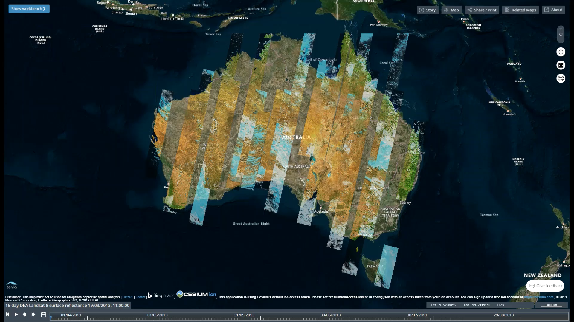
Further Work
Collect tiles at 10km or 5km zoom levels alone.
Concatenate the PNG files to create larger tiles.
May reduce the time to ~30 min per time slice.
These are just thoughts:
ArcGIS/QGIS:
Find a way to use time parameter in WMS query.
Possible use of KML files to do this.
Alter TerriaMap and GSKY to create/download KMLs.
Let ArcGIS read the KMLs (much like Google Earth).
NetCDF subsets:
Let GSKY save the tiles as NetCDF (WCS).
TerriaMap to download the NetCDFs (already possible?)
ArcGIS to read the NetCDFs.
Python code:
Develop Notebooks with useful Python code for analyses.
Animating GSKY output like a video.

Slide 13
Building tiles on the fly from cached tiles
These slides describe the details of changes in ows.go to build tiles on the fly from cached tiles.
SYNOPSIS
Currently, the ows.go is set to take the cached tiles for all zoom levels from 3000 to 10 km for two dates and from 3000 to 100 for others (Fig.1).
Instead of caching all levels, it could be more efficient to cache only one or a few levels and then construct the lower level tiles by appending these together.
Two options were:
Cache the 10km tiles.
Cache the 50km tiles.
Upon testing it became clear that generating the lower level tiles from the 10km building blocks will take increasingly more time (Fig.2). Hence, decided to cache more than one level and build not more than 2 lower levels from them.
Other considerations are:
The number of files and storage must be low.
The time to cache (one-off) must be low.
Building the tiles on the fly must be fast.
Caching the levels 10, 100 and 500 would satisfy the above and limit the building to 2 lower levels each. Another option is to cache 20, 200 and 1000. This will leave the 10km level to be fetched from GSKY directly. Both these options will be tested and the right one chosen.
Fig.1 - Dates and zoom levels cached
/local/avs900/Australia/DEA_Tiles/landsat8_nbar_16day
2013-03-19 – Cached from 3000 to 10km
2013-04-04 – Do.
2013-04-20 – Cached from 3000 to 100km
2013-05-06 – Do.
2013-05-22 – Do.
2013-06-07 – Do.
2013-06-23 – Do.
Fig.2 - Time to display the built tiles (sequential code)
20 km tile from 4 x 10 km tiles. – Takes < 1 sec to build and display
50 km tile from 16 x 10 km – 3 sec
100 km tile from 64 x 10 km – 23 sec
200 km from 256 x 10 km - 114 sec (1:54 min)
Lower zoom levels: Not tested, but will take 4x time at each level.
Parallelising the build process may reduce the times considerably.
This method is highly inefficient and should not be used for Terria.
It is useful to get tiles requested via scripts.
20 Aug 2019

Slide 14
Caching the tiles TL;DR
TL;DR
Setup GSKY (once) on Raijin login or PBS node.
python3 /short/z00/avs900/gsky/12082019/build_gsky.py
Start a Raijin PBS interactive node.
qsub -I -P z00 -q express -l ncpus=16 -l mem=32GB
Ingest data and start GSKY, GRPC and MAS servers.
python3 /short/z00/avs900/gsky/12082019/provision_single_node.py dea
Cache the tiles
Save ‘/short/z00/avs900/gsky/12082019/Australia/create_tiles_using_calculated_coords.pl’ in the $tiles_base directory.
$tiles_base = /short/z00/xxx900/gsky/12082019/Australia/landsat8_nbar_16day
cd $tiles_base
Run the script for a single date and zoom level as…
./create_tiles_using_calculated_coords.pl dc landsat8_nbar_16day 2013-03-19 10 #
For mutiple dates and zoom levels…
./create_tiles_using_calculated_coords.pl dc landsat8_nbar_16day 2013-03-19,2013-04-04,2013-04-20,2013-05-06,2013-05-22,2013-06-07,2013-06-23 3000,1000,500,300,200,100,50,20,10
To take dates and zoom levels from the script:
Edit create_tiles_using_calculated_coords.pl
401: @times = ("2013-04-20","2013-05-06","2013-05-22","2013-06-07","2013-06-23“,…);
410: @zoom_levels = (3000,1000,500,300,200,100,50,20,10);
./create_tiles_using_calculated_coords.pl dc landsat8_nbar_16day
# See the slide on “Errors and Pitfalls” for things to watch
The steps below are included in the above script. Giving here for manual run, if necessary.
Delete the blank tiles
cd /short/z00/avs900/gsky/12082019/Australia/landsat8_nbar_16day/2013-04-20/50
find . -name "*.png" -size -821c -exec rm -f {} \;
Gzip the files.
cd /short/z00/avs900/gsky/12082019/Australia/landsat8_nbar_16day/2013-04-20/50
tar cf landsat8_nbar_16day_2013-04-20_100.tar .
gzip landsat8_nbar_16day_2013-04-20_100.tar
rm -f *.png
Transfer the tiles to the GSKY server (e.g. 130.56.242.15)
to the GSKY server (e.g. 130.56.242.15)
cd /local/xxx900/Australia/DEA_Tiles/landsat8_nbar_16day/
rsync -avzh xxx900@raijin.nci.org.au:/short/z00/xxx900/gsky/12082019/Australia/landsat8_nbar_16day/ .
cd 2013-04-04
tar xf 50/*.gz; tar xf 20/*.gz; etc.
For an unknown reason, probably due to large size, some tiles time out.
ows.go:433: WMS pipeline timed out, threshold:900 seconds
Seems to happen randomly and is probably not size-depended.
If it happens to the same tile repeatedy, then the timeout must be increased in ows.go.

Slide 15
Setup GSKY and MAS servers and ingest the data
Fig.1 - provision_single_node.py: (only the edited lines are shown below)
10 try:
11 dataset = sys.argv[1]
12 except:
13 sys.exit('ERROR: Must specify a dataset. e.g. "python3 provision_single_node.py dea". Exitting!’)
33 GSKY_GRPC_POOL_SIZE=32,
36 crawl_files = ''
37 url = ''
38 conf_json = ‘’
45 if dataset == 'dea':
46 crawl_files = ['/short/z00/avs900/dea_crawls/landsat8_nbar_avs.gz’,]*
48 url = '%s/ows?time=2019-05-07T00:00:00.000Z&srs=EPSG:3857&transparent=true&format=image/png&exceptions =application/vnd.ogc.se_xml&styles=&tiled=true&feature_count=101&service=WMS&version=1.1.1&request=GetMap& layers=landsat5_nbar_16day&bbox=15341217.324948017,-2974317.644632779,15419488.841912035,-2896046.127668757 &width=256&height=256' % envs.envs['GSKY_OWS_HOSTNAME’]
51 conf_json = conf.get_config_json(conf_file=os.path.join(curr_path, 'assets/gsky_layers/dea_nbar.yaml’**))
97 finally:
98 # ows.stop()
99 # mas.stop()
100 # worker.stop()
102 print ("Finished! Leaving the servers running.")
--------------------------------------------------------------------------------------------------------------------------------------------------------------------------------------------
*Created as below.
gunzip rs0-landsat.gz
grep NBAR rs0-landsat | grep -v NBART > landsat8_nbar_avs
gzip landsat8_nbar_avs
**Created as below:
cp /short/z00/avs900/gsky/12082019/assets/gsky_layers/dea.yaml dea_nbar.yaml
Edit dea_nbar.yaml to remove all lines except…
layers:
- "dea/layers/landsat/nbar.yaml***"
processes: []
Setting up the GSKY/GRPC servers and MAS database
Caching is done on Raijin PBS nodes (interactive, but will use batch queues later).
STEPS
Setup GSKY and all dependencies on Raijin – once only.
Setup the MAS database and start GSKY on PBS nodes – each time.
Run the caching script.
Setup GSKY:
Create a directory under ‘raijin:/short/z00/avs900/gsky/’
git clone git@git.nci.org.au:jxg900/gsky_provisioning.git
Rename ‘gsky_provisioning’ to ‘12082019’ (unique date as dirname)
Download and install Anaconda3.
curl ‘url’
cd /short/z00/avs900/gsky/12082019
Run ‘python3 build_gsky.py’
Will take > 30 minutes for first installation.
Setup MAS and ingest the data:
Start an interactive PBS session.
qsub -I -P z00 -q express -l ncpus=16 -l mem=32GB or,
qsub -I -P z00 -q normal -l ncpus=16 -l mem=32GB
Edit /short/z00/avs900/gsky/12082019/provision_single_node.py (Fig.1)
python3 /short/z00/avs900/gsky/12082019/provision_single_node.py dea #
Takes 10min. to complete
Must create a ‘test_wms.png’ of size > 820
It will leave the GSKY, GRPC and MAS servers running.
Run the caching script (next slide)
# See the slide on “Errors and Pitfalls” for things to watch
*** Edited lines below.
88 data_source: "/g/data2/rs0/datacube/002/LS8_OLI_NBAR“
- changed ‘/g/data’ to ‘g/data2’

Slide 16
Caching the tiles - Instructions
Setup GSKY and MAS
Edit the ‘ows.go’ to disable timeout and zoom limits
vi /short/z00/xxx900/gsky/12082019/gsky/gopath/src/github.com/nci/gsky/ows.go
347: conf.Layers[idx].WmsTimeout = 900
356: conf.Layers[idx].ZoomLimit = 0.00
Re-run ‘python3 /short/z00/xxx900/gsky/12082019/build_gsky.py’
Start an interactive PBS que on Raijin…
qsub -I -P z00 -q normal -l ncpus=16 -l mem=32GB
Run ‘python3 /short/z00/avs900/gsky/12082019/provision_single_node.py dea’
Cache the tiles
Save ‘/short/z00/avs900/gsky/12082019/Australia/create_tiles_using_calculated_coords.pl’ in the $tiles_base directory.
$tiles_base = /short/z00/xxx900/gsky/12082019/Australia/landsat8_nbar_16day
cd $tiles_base
Run the script for a single date and zoom level as…
./create_tiles_using_calculated_coords.pl dc landsat8_nbar_16day 2013-03-19 10 #
For mutiple dates and zoom levels…
./create_tiles_using_calculated_coords.pl dc landsat8_nbar_16day 2013-03-19,2013-04-04,2013-04-20,2013-05-06,2013-05-22,2013-06-07,2013-06-23 3000,1000,500,300,200,100,50,20,10
To take dates and zoom levels from the script:
Edit create_tiles_using_calculated_coords.pl
401: @times = ("2013-04-20","2013-05-06","2013-05-22","2013-06-07","2013-06-23“,…);
410: @zoom_levels = (3000,1000,500,300,200,100,50,20,10);
./create_tiles_using_calculated_coords.pl dc landsat8_nbar_16day
Transfer the tiles
to the GSKY server (e.g. 130.56.242.15)
cd /local/xxx900/Australia/DEA_Tiles/landsat8_nbar_16day/
rsync -avzh xxx900@raijin.nci.org.au:/short/z00/xxx900/gsky/12082019/Australia/landsat8_nbar_16day/ .
cd 2013-04-04
tar xf 50/*.gz; tar xf 20/*.gz; etc.
# See the slide on “Errors and Pitfalls” for things to watch

Slide 17
Errors and Pitfalls
The programs do not always run perfectly. Details are given below.
‘python3 /short/z00/avs900/gsky/12082019/provision_single_node.py dea’
This command creates the MAS database and ingests the data. Occasionally it runs into problems and must be watched.
worker.start()
The number of GRPC servers is set as 2, which is not enough. Change it to 32
worker.py: 18 self.envs['GSKY_GRPC_POOL_SIZE'] = '32'
The default timeout specified in worker.py is 5 and is often not sufficient. Change it to 30
worker.py: 36 worker_timeout = 30
mas.ingest_data(crawl_files)
An error, which does not seem to affect the operations, happens at the command below.
+ bash ingest_pipeline.sh rs0_datacube /short/z00/avs900/dea_crawls/landsat8_nbar_avs.gz
/short/z00/avs900/gsky/12082019/gsky/bin/concurrent
ERROR: relation "rs0_datacube.paths" does not exist at character 18
Data crawl will fail if the right path is not edited in.
- dea/layers/landsat/nbar.yaml: 88 data_source: "/g/data2/rs0/datacube/002/LS8_OLI_NBAR“
- change ‘/g/data’ to ‘g/data2’
While running the caching script there are occasional errors in GRPC
ows.go:427: Error in the pipeline: rpc error: code = Internal desc = unexpected EOF
This is out of our control, but will skip creating one tile.
Handled the situation by running the sub again, after deleting the incomplete PNG files
It is a heuristic that relies on the fact that a broken GRPC pipe will not happen twice to the same GSKY call.
For an unknown reason, probably due to large size, some tiles time out.
ows.go:433: WMS pipeline timed out, threshold:900 seconds
This will cause losing a tile.
Seems to happen randomly and is probably not size-depended.
If it happens to the same tile repeatedy, then the timeout must be increased in ows.go.
Handled the situation by running the sub again, after deleting the incomplete PNG files.
Total time for a time slice is affected by the speed of creating the tiles as well as random errors that cause a GSKY call to exit. If it happens, but the ‘curl’ call is still running, it will wait for a timeout of 900 seconds before trying again. Thus, even one broken pipe among the hundreds of running curls can cause excessive time to complete the caching for that time slice.
Reducing the timeout to less than 900 seconds does not work, as there are often one or two tiles that takes long time. It will then cause a recurring run of a subroutine which always times out.
It is taking 1.5 hours per time slice. The average across sparse and full time slices may be around a third of it.

Slide 18
Build tiles on the fly - Introduction
Changes in GSKY code to build tiles on the fly
There are two purposes for which the tiles are built, instead of using the cached tiles directly.
For standard TerriaMap calls to the GSKY server.
For calls from Python scripts that may not have standard BBOX coordinates.
Advantages
Caching only a few levels will reduce storage and CPU.
Non-standard BBOX calls can be served.
BBOX in EPSG:4326 can be handled.
Disadvantages
It will take time to create the tiles on the fly.
Display will not be as fast as using the cached tiles directly.
Conclusion: Do Not ‘Build Tiles On The Fly’ For Terria !
Due to the overheads in appending smaller tiles to make larger ones, it will never achieve the speed seen with cached tiles at all levels.
By not caching all levels we are only saving ~400MB storage per time slice from ~1.2GB total. The time to cache the tiles is about halved by taking only 3 levels. This saving is more than lost in the higher delivery times in Terria.
Considering the relatively low gains, but significant loss in functionality, the building of tiles on the fly is not viable. Therefore, for Terria we must cache all levels and use the cached tiles.
For scripts and other non-standard bounding boxes, we can use the new code to build and/or crop subsets of tiles. The same cached tiles can be used for this.
10 Sep 2019

Slide 19
Build the tiles on the fly – TIFF vs PNG
To solve the speed issue of building the tiles on the fly, there was a suggestion that instead of PNGs and ImageMagick use TIFFs and GDAL. This will be even more time and space consuming for the following reasons.
The *.tiff tiles are around 60x larger than a corresponding *.png tile.
For PNGs:
• Total number of cached tiles for two dates: 18,745
• Total size: 1,944 M
• Average per tile: 104 KB
• Average tiles per time slice: 9,238
• Total size of PNG: 9,238 * 104 = 0.92 GB per time slice.
o Assuming that the average will be 1/3rd of it across 16K tiles: 0.3 GB per time slice
• Total size for 16,000 tiles: 4.8 TB
For TIFFs:
• Tiff file size: 6.1 M. Based on just one tile. Let us assume that the average will be 4M
• Total size of Tiff: 9,238 * 4 = 36 GB per time slice.
o Assuming that the average across 16K tiles will be 1/3rd of it: 12 GB per time slice.
• Total for 16,000 time slices: 188 TB
• If caching only three zoom levels: 125 TB
As seen from a ‘top’ command, the GDAL processes take a lot longer than the ‘convert’
This could be due to the fact that lots of calculations are needed to build tiles from NetCFDs.
I suspect that similar amounts will be needed to combine tiles saved as TIFFs.
TIFFs will not work for another reason too. To optimise the speed, the blank tiles are skipped altogether. Instead the system caches just one blank tile. The number of blanks will far exceed the tiles with data. If using TIFFs, we will not be able to skip them, which means the storage requirement will be several times than above.
Furthermore, using GDAL to read and build a tile from TIFFs will be defeating the purpose of caching the tiles.

Slide 20
Comparison of various methods - Introduction
So far, three different methods have been tried as below.
Directly from NetCDFs (current).
Cached PNGs at all zoom levels.
Building tiles on the fly.
In a meeting on 20/9/19 it was decided to try another method suggested by Edison.
Technical details are unclear to me.
Also decided was to use the various methods in ArcGIS/QGIS to come up with an optimal solution.
The slides 21 - 30 give these comparisons and their relative merits.
Slide 31 gives some observations.

Slide 21
Comparison of various methods
In the next several slides the screen shots will be arranged in the following order.
NetCDF : The current version of GSKY; reading the NetCDFs to create tiles.
PNG : Cached tiles at all zoom levels.
Pyramid : Edison’s new method; display in Terria
Pyramid : Do. Display in ArcGIS
Note: Due to restrictions between the four different interfaces it is not possible to use the same dates. The dates used are shown in each cell below.
NetCDF (Current) 07/05/2019
PNG (Cached) 19/03/2013
Pyramid (Terria) 05/05/2019
Pyramid (ArcGIS) 05/05/2019

Slide 22
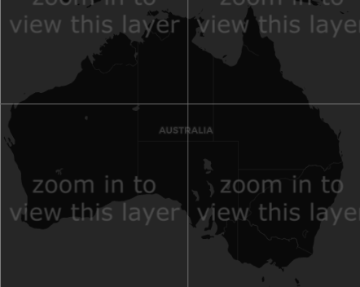
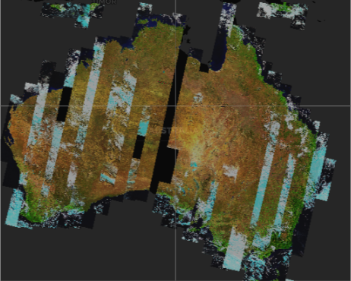
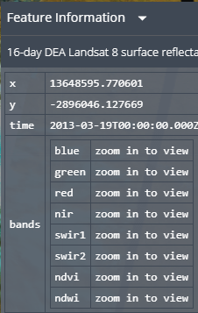
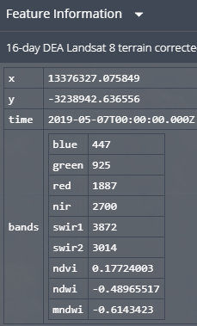
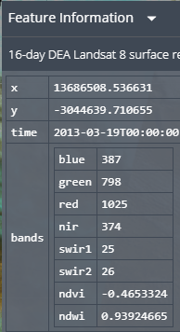
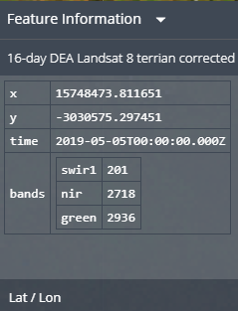
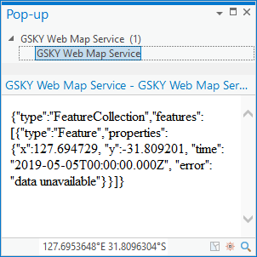
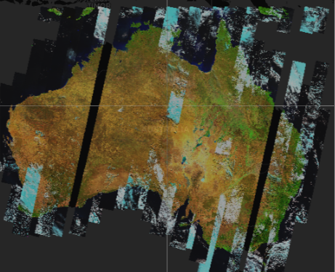
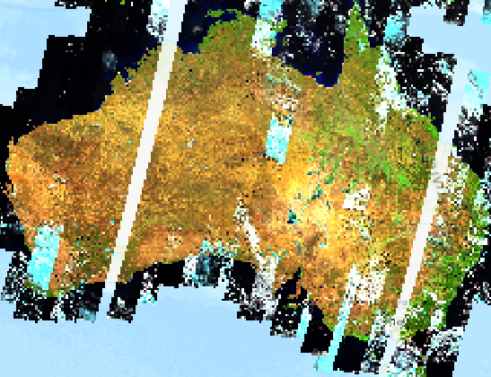
Comparison of various methods
Layer: 16-day DEA Landsat 8 terrain corrected surface reflectance
Zoom level: Continent at 500 km
Must view this slide as a slide show
Time to paint: Less than 1 sec in all cases.
NetCDF
PNG
Continent-level display of the layers
Current system does not display anything until the 50 km zoom level.
PNG and Pyramid display continent level in less than 1 sec.
FeatureInfo shows 9 bands in NetCDF and PNG, but only 3 in Pyramid.
The bands’ data is nil in PNG in 100 km to 3000 km
PNG does not display well in ArcGIS.
Pyramid displays in ArcGIS but the resolution is lower.
FeatureInfo does not show bands in ArcGIS (see below).
PNG – 50km
PNG – 100 km
Pyramid – 100 km
ArcGIS
Pyramid (Terria)
Pyramid
(ArcGIS )
1:31,250,000

Slide 23
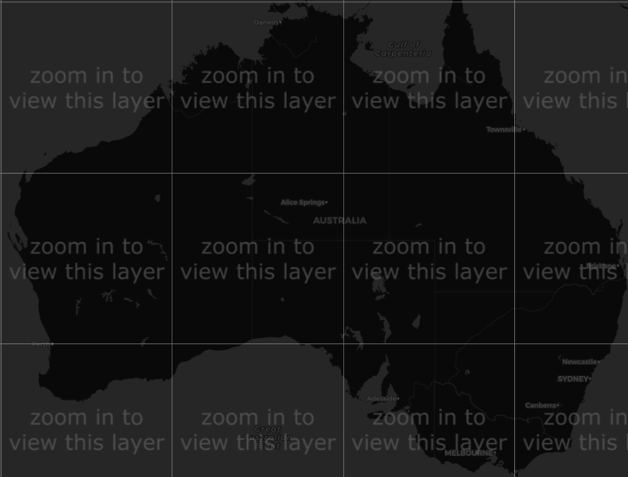
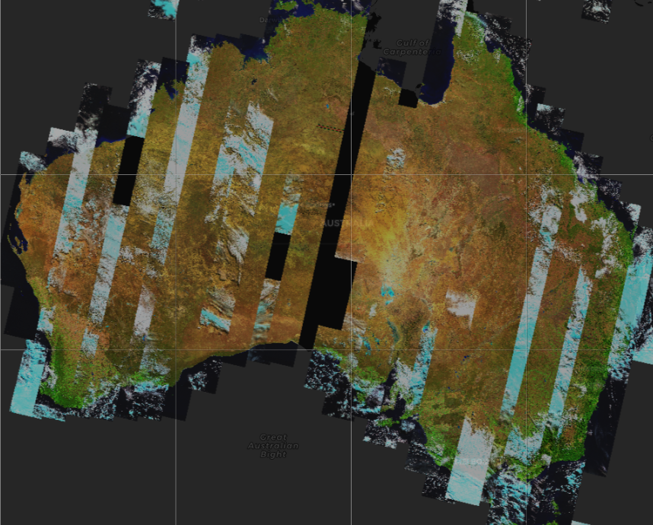
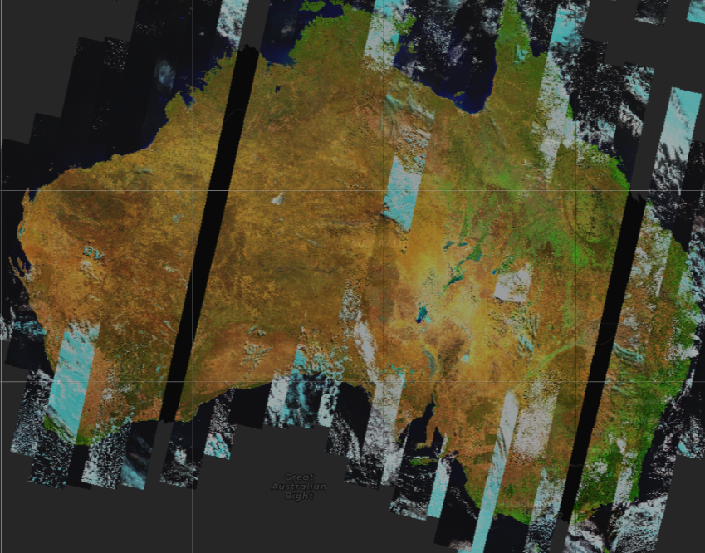
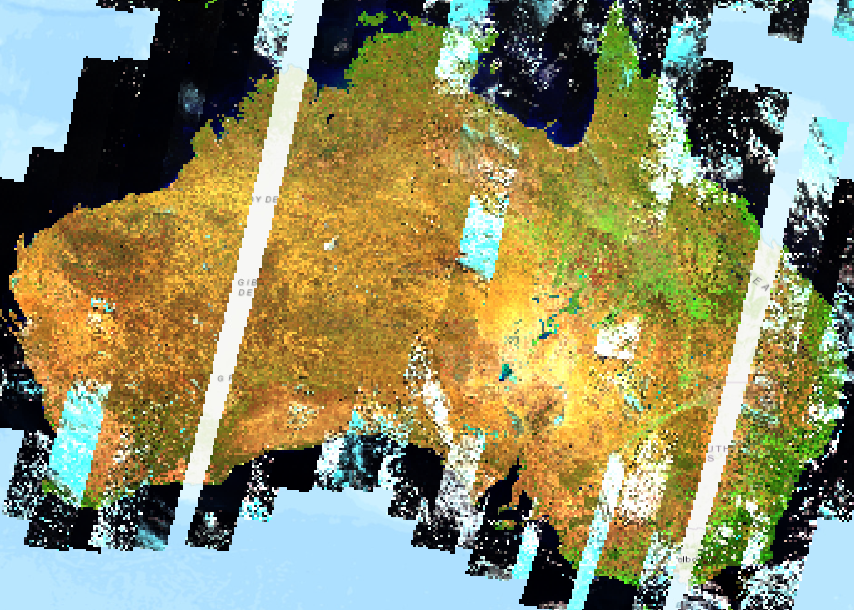
Comparison of various methods
Layer: 16-day DEA Landsat 8 terrain corrected surface reflectance
Zoom level: Continent at 300 km
NetCDF
PNG
Time to paint: Less than 1 sec in all cases.
Pyramid
ArcGIS
1:20,000,000

Slide 24
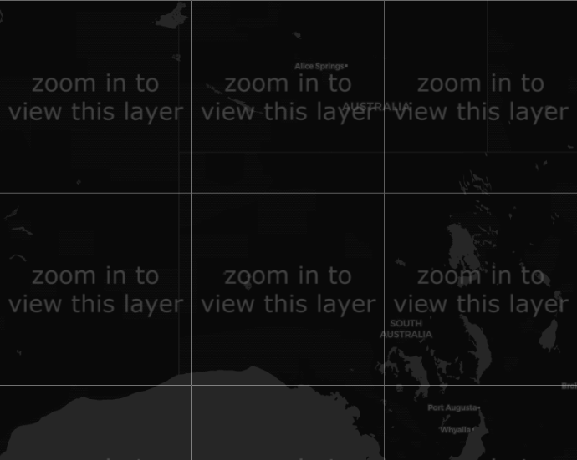
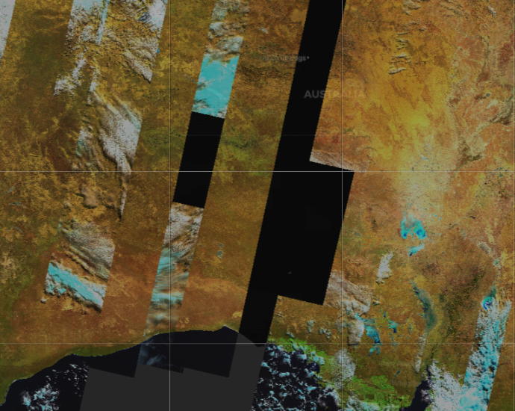
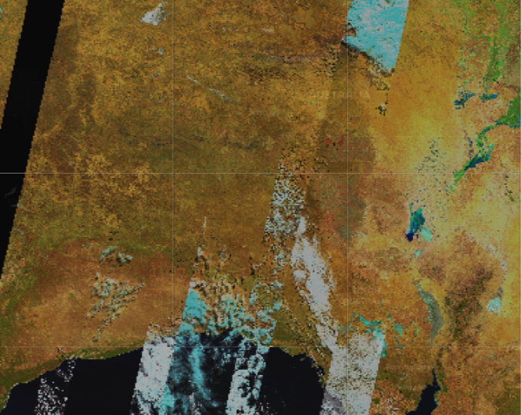
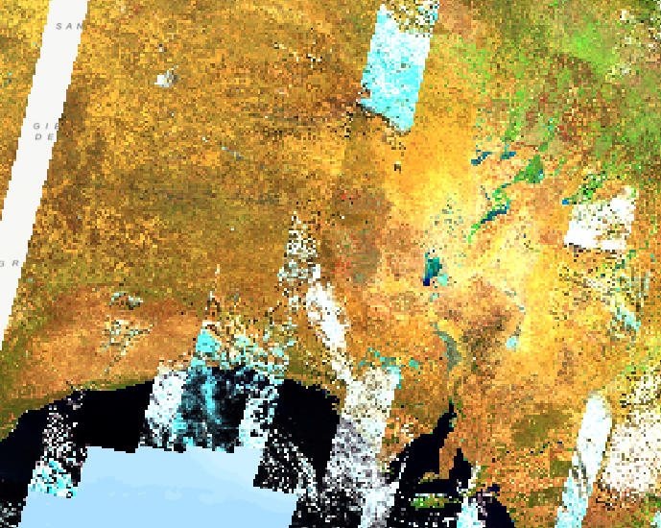
Comparison of various methods
Layer: 16-day DEA Landsat 8 terrain corrected surface reflectance
Zoom level: Continent at 200 km
NetCDF
PNG
Time to paint: Less than 1 sec in all cases.
Resolution begins to degrade in Pyramid.
Pyramid
ArcGIS
1:12,800,000

Slide 25
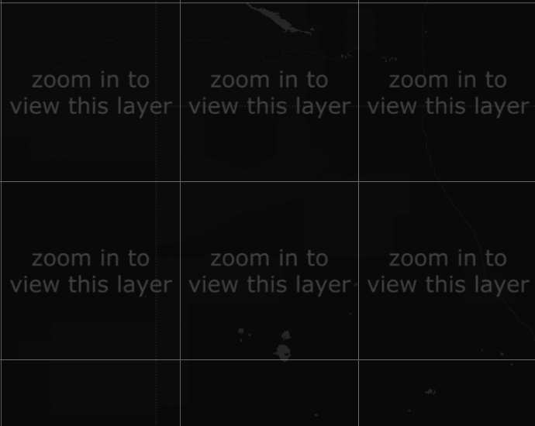
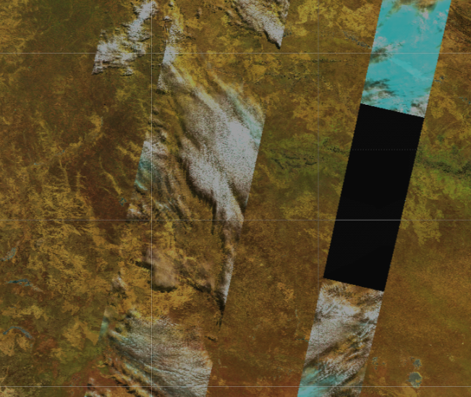
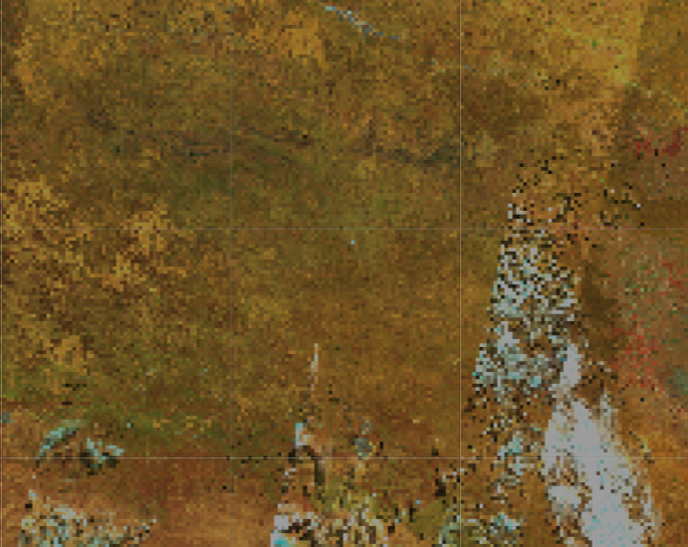
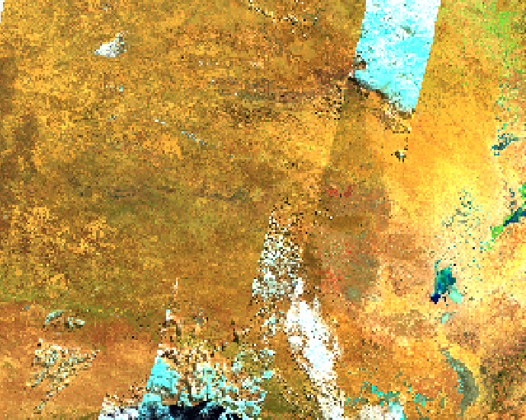
Comparison of various methods
Layer: 16-day DEA Landsat 8 terrain corrected surface reflectance
Zoom level: Continent at 100 km
NetCDF
PNG
Time to paint: Less than 1 sec in all cases.
Pyramid
ArcGIS
1:8,192,000

Slide 26
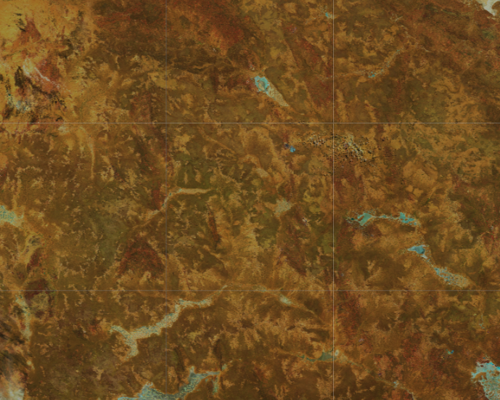
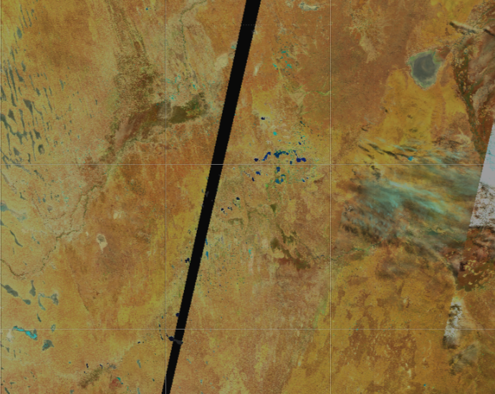
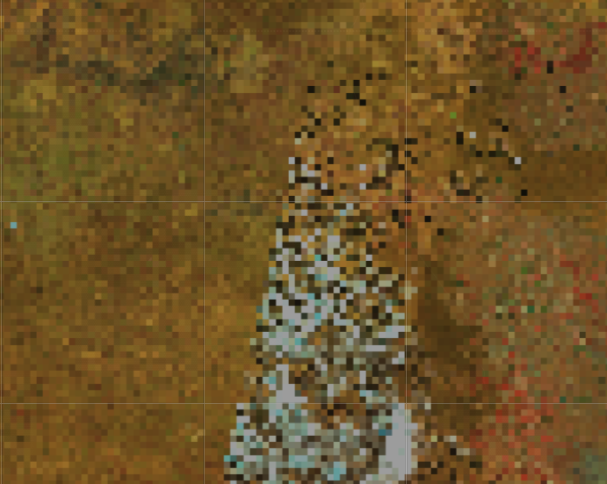
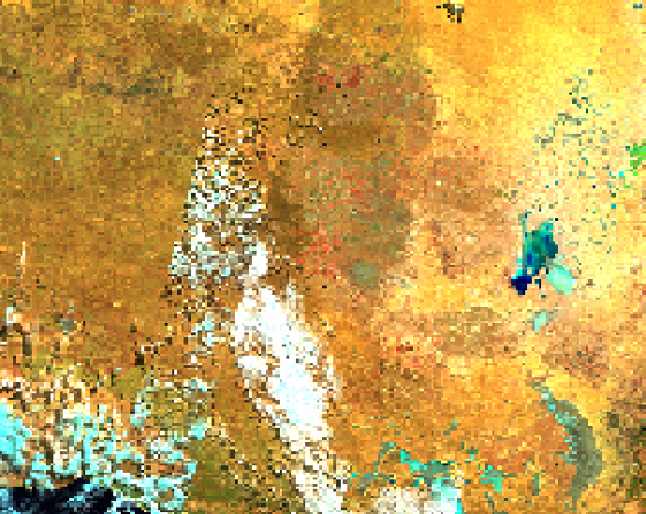
Comparison of various methods
Layer: 16-day DEA Landsat 8 terrain corrected surface reflectance
Zoom level: Continent at 50 km
NetCDF
PNG
Time to paint: All < 1 sec except,
NetCDF: 47 sec.
Resolution is very poor in Pyramid.
Edison says that it will not happen on production server.
Would be nice to see it.
Pyramid
ArcGIS
1:8,192,000

Slide 27
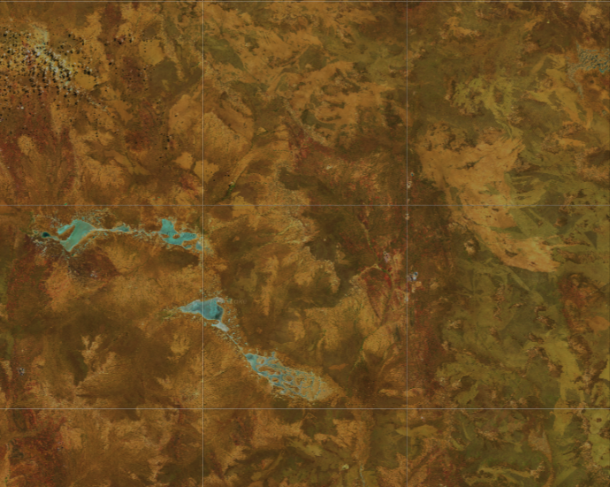
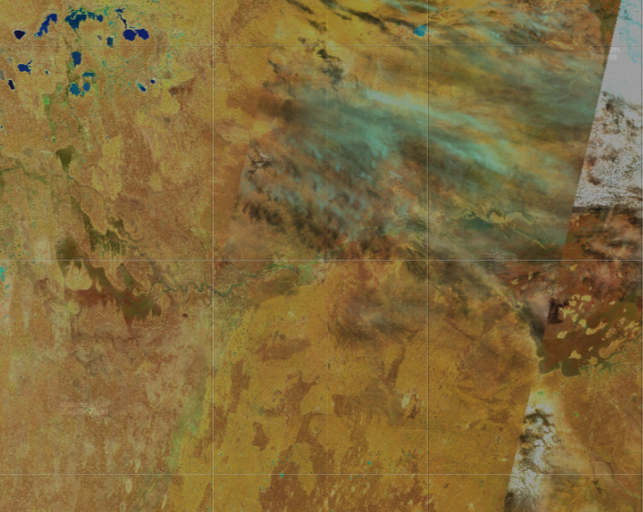
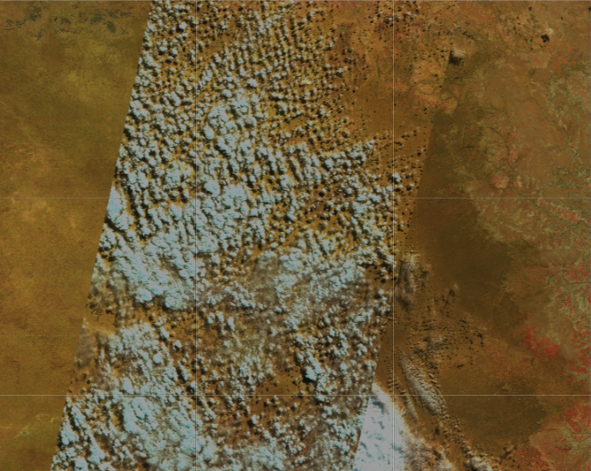
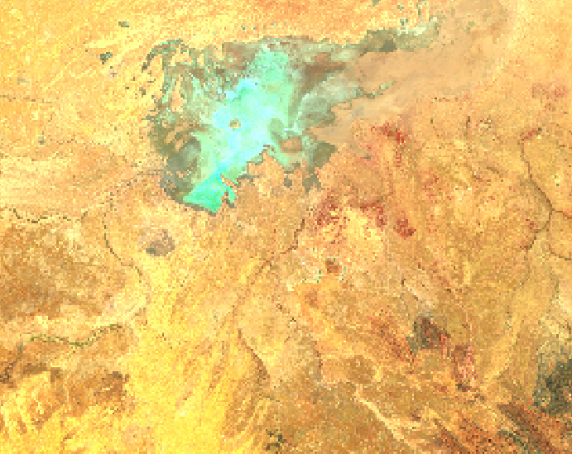
Comparison of various methods
Layer: 16-day DEA Landsat 8 terrain corrected surface reflectance
Zoom level: Continent at 20 km
NetCDF
PNG
Time to paint:
PNG: < 1 sec
NetCDF: 18 sec.
Pyramid: 20 sec.
ArcGIS: 4 sec
Resolution returns to normal in Pyramid.
This could indicate that the layer is now coming from NetCDF.
Please confirm.
Pyramid
ArcGIS
1:562,950

Slide 28
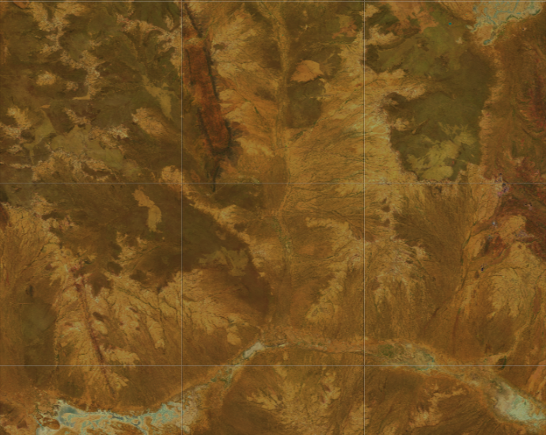
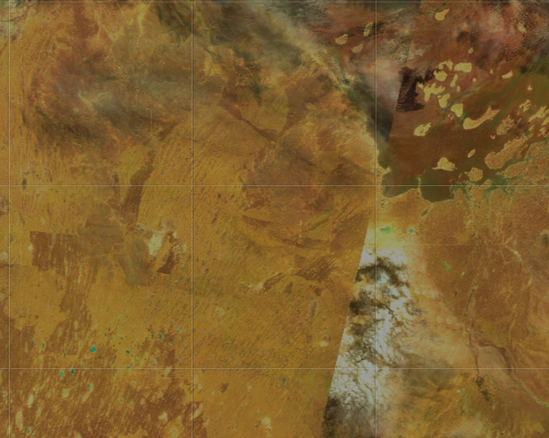
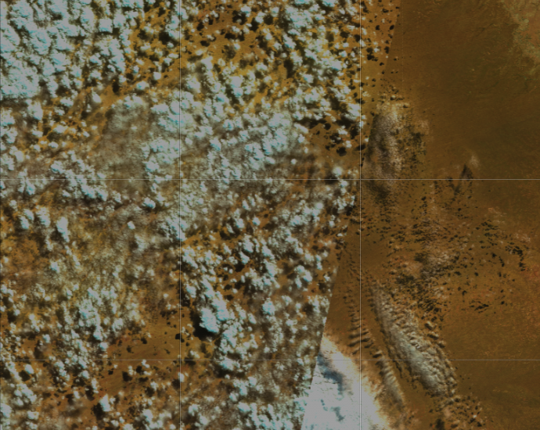
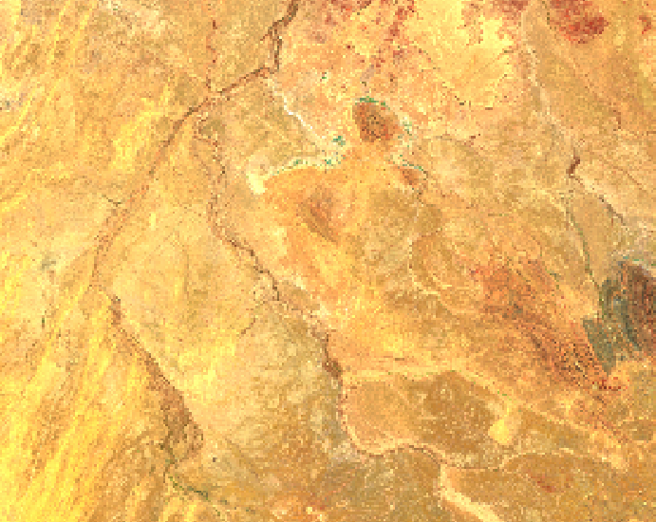
Comparison of various methods
Layer: 16-day DEA Landsat 8 terrain corrected surface reflectance
Zoom level: Continent at 10 km
NetCDF
PNG
Time to paint:
PNG: < 1 sec
NetCDF: 6 sec.
Pyramid: 10 sec.
ArcGIS: 4 sec
Pyramid
ArcGIS
1:230,584

Slide 29
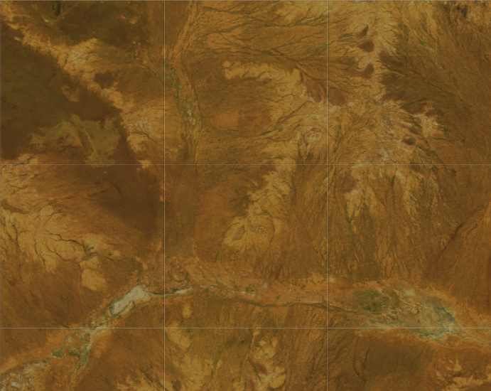
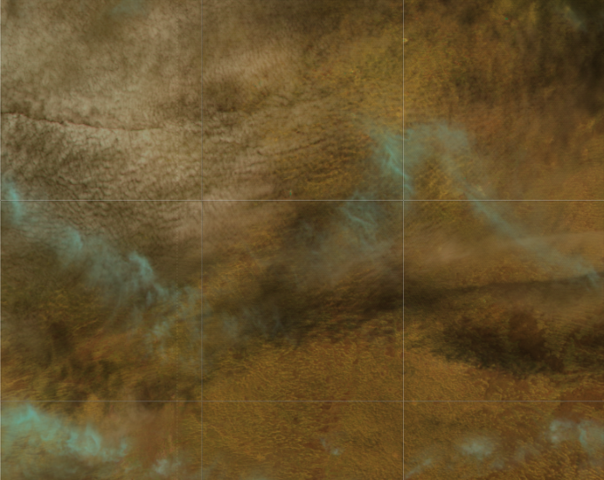
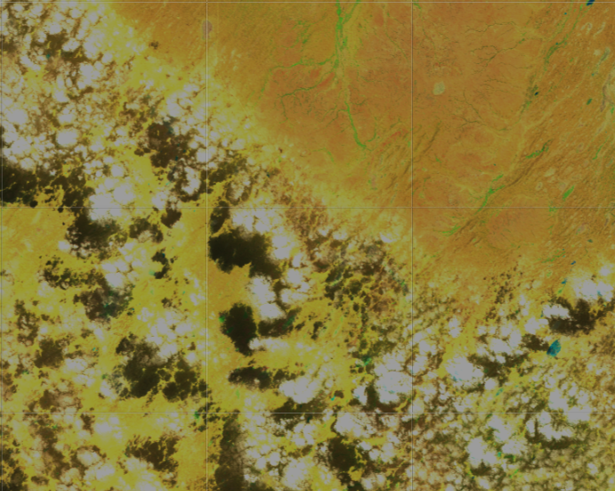
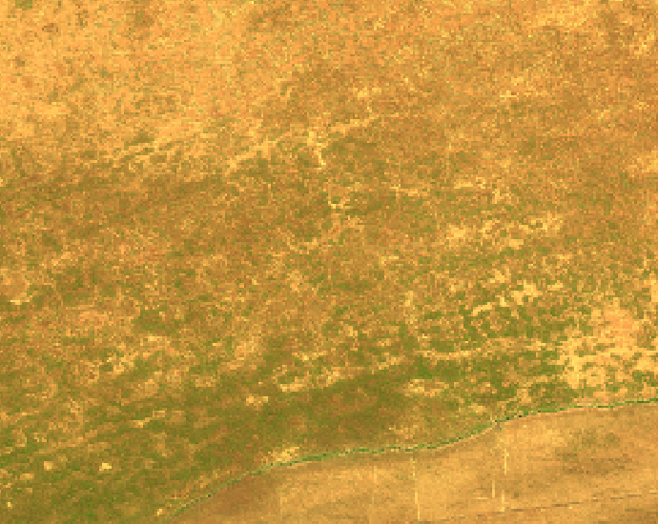
Comparison of various methods
Layer: 16-day DEA Landsat 8 terrain corrected surface reflectance
Zoom level: Continent at 5 km
NetCDF
PNG
Time to paint:
PNG: 6 sec
NetCDF: 6 sec.
Pyramid: 6 sec.
ArcGIS: 4 sec
Pyramid
ArcGIS
1:154,089

Slide 30
Pros and Cons
There are Pros and Cons for the three methods
METHOD | PROS | CONS
NetCDF | No change in GSKY code | No continent view Slow display
PNG – Full caching | Instant display at all zoom levels | High storage space High caching time Feature Info not seen at above 50km It is probably fixable
PNG – Build on the fly | Less storage space Less caching time | Increased display time Feature Info may be lost
Pyramid | Less storage space Less caching time | Additional dataset in MAS Low resolution at high zoom levels May not be an issue on production
ArcGIS via NetCDF | No change in GSKY code | No display above zoom level Very long time to come up
ArcGIS via PNG | Instant display at all zoom levels | Not working at present Low resolution (ArcGIS issue) No Feature Info (ArcGIS issue)
ArcGIS via Pyramid | Instant display at all zoom levels | Low resolution (ArcGIS issue) No Feature Info (ArcGIS issue)
Strong Pro
Strong Con
Potential Con

Slide 31
Differences between Terria and ArcGIS
ArcGIS and Terria have differences in the way WMS queries are sent and the returned data is displayed.
Terria sends several WMS requests, one for each tile, for two time slices.
All these calls request a 256 x 256 PNG image.
GSKY constructs a PNG image from the NetCDFs and send it for each tile.
ArcGIS sends just one WMS request for the entire canvas.
This is at variable width and height, with neither exceeding 512 pixels.
The received image is displayed over the canvas whose surface area exceeds 256x256.
To fill the area at 300km zoom level, Terria uses up to 10x5 tiles of 256x256 pixels
i.e. 2560 x 1280 pixels
Layers’ area: 4x4 tiles or 1024x1024 pixels.
ArcGIS fills the same area with a single tile of maximum 512 x 512 pixels.
Probably the resolution goes down in ArcGIS because of this.
Solution (maybe): Construct tiles at higher pixel density and let ArcGIS compress it.
It will not work if ArcGIS crops it, instead of compressing, to fit inside the canvas.
Both Pyramid and PNG have similar resolution at lower zoom levels.
They diverge as the zoom level increases up to the 50 km level where it is very pixelated.
Edison says that it will only happen in the Dev environment and will not be an issue on production.
I do not understand the logic fully.
Pyramid is working only up to the 50 km zoom level.
Beyond it the data is fetched from NetCDFs as of now.
PNG is working up to the 10km zoom level and then the data is fetched from NetCDFs.

Slide 32
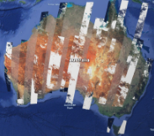
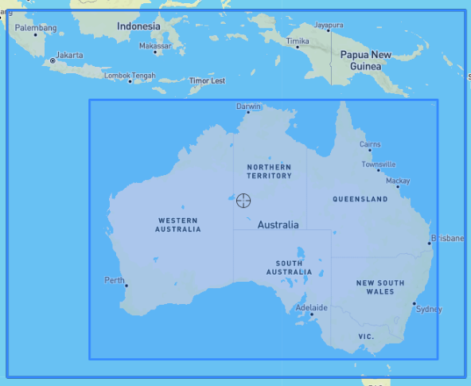

Using cached PNGs with ArcGIS - Process
This is only partially working now. If the Pyramid with ArcGIS is suitable, there is no need to go this route.
METHOD
Receive the WMS query for a single tile of 512x340 pixels
There is no ‘time’ param in the query. The last date in config is taken as default.
The coordinates are in CRS:84 (same as EPSG:4326)
This gives an error in GSKY code. So, change it to EPSG:4326 first.
The coordinates are then converted into EPSG:3857
Find an enclosing BBOX based on the selected BBOX (see below)
This part is not working! The layers and map do not align.
Inner tile, requested by ArcGIS
Send to ArcGIS as the required size
Build the outer tile from 16x300km cached tiles (or 4x500 tiles)
Crop and resize the inner tile

Slide 33
PNG with ArcGIS – Time Param
Workaround for the time parameter issue
Create multiple configs with a single date or a single year with multiple dates.
Compile GSKY with these configs as separate name spaces.
e.g. GetCap end points:
http://130.56.242.15/ows/ls8_19-03-2013
http://130.56.242.15/ows/ls8_04-04-2013
etc.
Provide the GetCaps endpoints on a web page.
Either as hard coded links to copy.
Or dynamically create from user selection of dates and layer.
Alternatively, use a separate config for each year
Specify each date as separate layers.
http://130.56.242.15/ows/ls8_2019
19-03-2013
04-04-2013
etc.
This could be technically challenging and may require re-ingestion of data into MAS.

Slide 34
End of Slides
End of Slides
25 Sep 2019

Slide 35






Acknowledgements

